Slide 1
Spark Terasort Competition
Wong Ngai Sum 3035380875

Slide 2
Fastest trial: 104s (p. 75)

Slide 3
Bad approach
Change multiple parameters at the same time without thinking how it may impact the performance, and see if it performs well…
Tried > 10 times but have no luck. It is hard to see how a parameter can impact performance...

Slide 4
Try to change a lot of parameters at once… (Bad)
spark-submit --driver-cores 1 --driver-memory 1g --num-executors 11 --executor-cores 1 --executor-memory 1g --conf spark.rdd.compress=True --conf spark.shuffle.consolidateFiles=True --conf spark.shuffle.memoryFraction=0.3 --conf spark.reducer.maxSizeInFlight=96m --conf spark.shuffle.file.buffer=64k --conf spark.locality.wait=1 --conf spark.shuffle.compress=True --conf spark.memory.fraction=0.6 --conf spark.memory.storageFraction=0 --conf spark.default.parallelism=79 --class TeraSort --master yarn target/terasort-application-1.0.jar /terainput20g-256m /user/wongngaisum/spark_teraoutput-wns-1
Link: http://202.45.128.135:10669/history/application_1626360248822_0381/1/jobs/
Execution time: 171s...

Slide 5
Change my strategy
Strategy:
Use simpler configuration.
Then try different values for a specific parameter and choose the best parameter to continue.
It is worse than grid search but it saves more time.

Slide 6
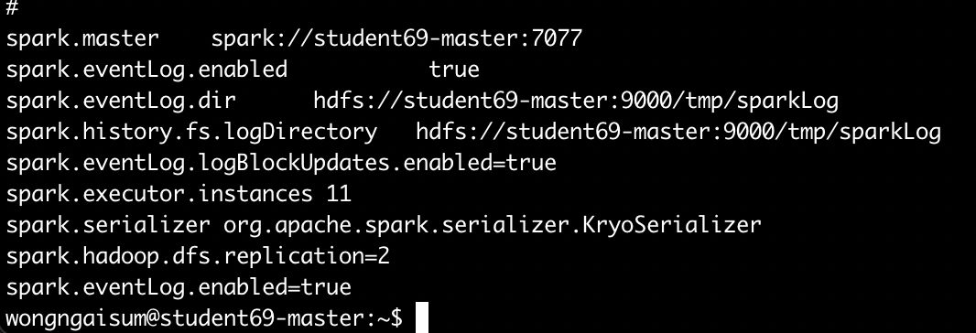
My base line configuration
Same as TA’s with the following additional changes:
--driver-cores 1
--driver-memory 1g
--num-executors 11
--executor-cores 1
--executor-memory 2g
spark.shuffle.compress=true
spark.default.parallelism=300
I am going to set different values of each parameter to see how it impacts the performance.

Slide 7
Change Block Size

Slide 8
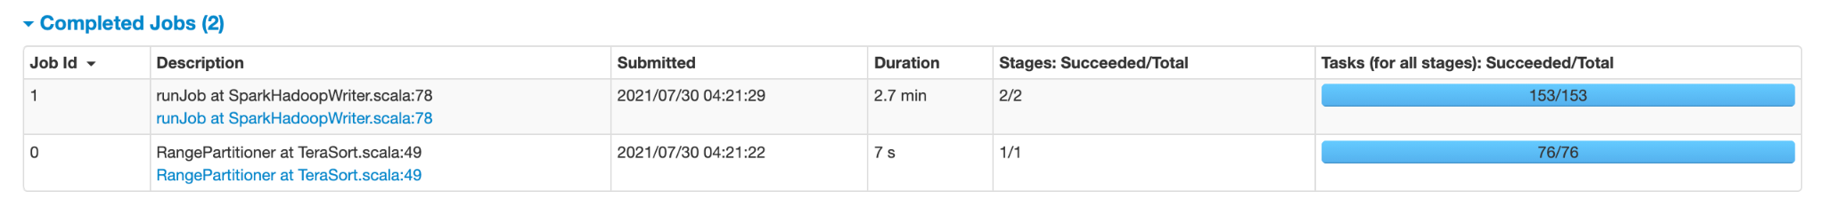
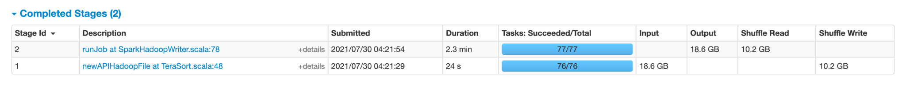
Basic configuration with 256MB blocksize
spark-submit --driver-cores 1 --driver-memory 1g --num-executors 11 --executor-cores 1 --executor-memory 2g --conf spark.shuffle.compress=true --conf spark.default.parallelism=300 --class TeraSort --master yarn target/terasort-application-1.0.jar /terainput20g-256m /user/wongngaisum/spark_teraoutput-wns-1
Link: http://202.45.128.135:10669/history/application_1626360248822_0385/1/jobs/
Execution time: 169s
Lets focus on Job 1 stage 2 as it is the most time consuming part
Job 1

Slide 9
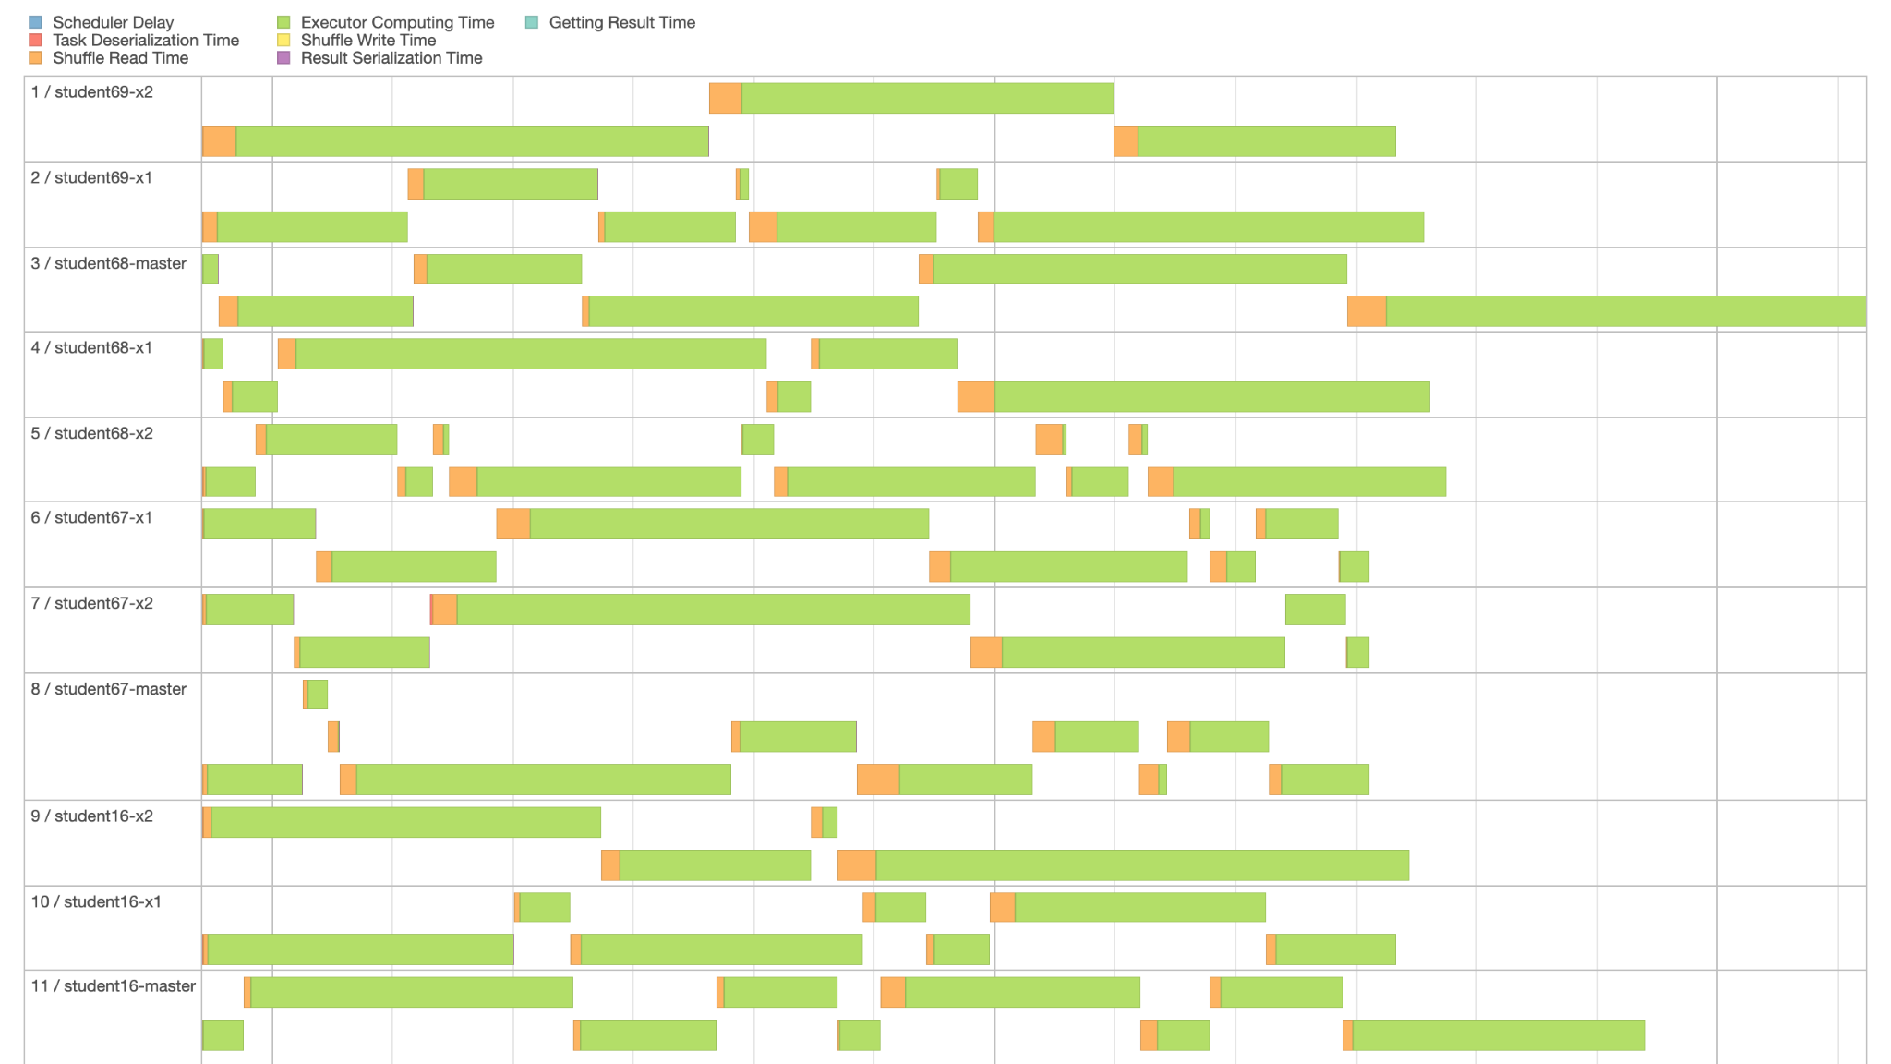
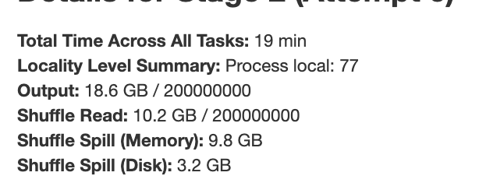
Basic configuration with 256MB blocksize
Execution time: 169s
Total 77 tasks
Each node runs 7 task on avg.
=> Is it good to increase block size,
so that workload can split more evenly?
Data skew problem...
Also, 3.2GB data spilled to disk (high latency)...

Slide 10
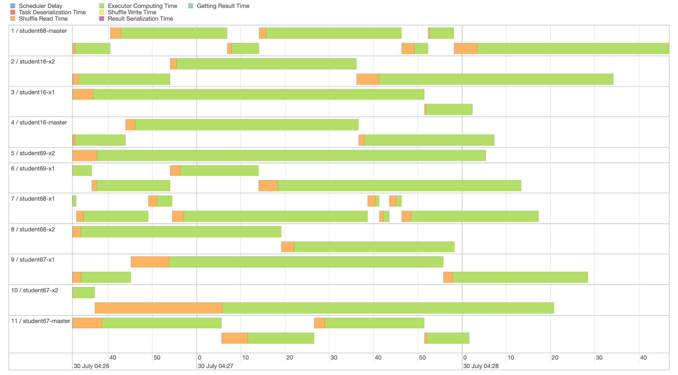
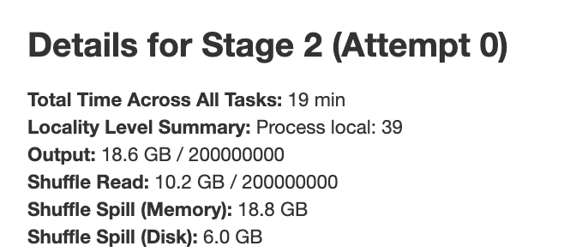
Basic configuration with 512MB blocksize
spark-submit --driver-cores 1 --driver-memory 1g --num-executors 11 --executor-cores 1 --executor-memory 2g --conf spark.shuffle.compress=true --conf spark.default.parallelism=300 --class TeraSort --master yarn target/terasort-application-1.0.jar /terainput20g-512m /user/wongngaisum/spark_teraoutput-wns-1
Link: http://202.45.128.135:10669/history/application_1626360248822_0386/1/jobs/
Execution time: 183s, longer execution time
Each executor runs 3.5 tasks on avereage,
but their size varies a lot
Data skew problem again...
6GB data spilled to disk, also some tasks suffered from long shuffle read. 1GB memory for an executor but block size is too large, memory fraction for shuffle is not large enough… High GC time...

Slide 11
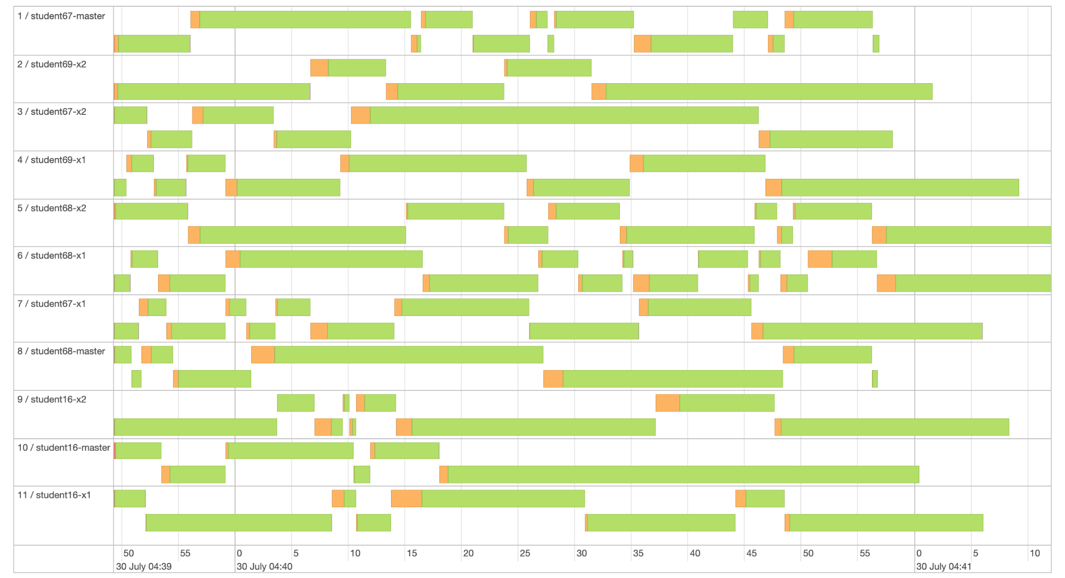
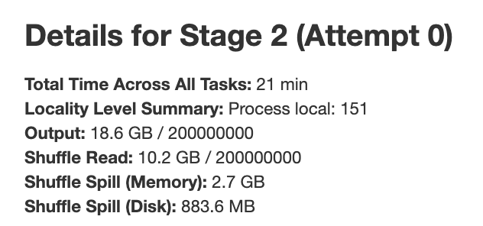
Basic configuration with 128MB blocksize
spark-submit --driver-cores 1 --driver-memory 1g --num-executors 11 --executor-cores 1 --executor-memory 2g --conf spark.shuffle.compress=true --conf spark.default.parallelism=300 --class TeraSort --master yarn target/terasort-application-1.0.jar /terainput20g-128m /user/wongngaisum/spark_teraoutput-wns-1
Link: http://202.45.128.135:10669/history/application_1626360248822_0389/1/jobs/
Execution time: 151s, fastest among the 3 values
Quite balanced workload, good!
Little data spilled to disk, good!

Slide 12
Effects of changing block size
Among the three values I test, block size = 128 gives the best result. The workloads among executors are more balanced so the exectuion time is faster. Also, less data spilled to disk so memory swap-ins/outs happened less. This also improves execution speed.
I will use block size = 128 along with my basic configuration to test other parameters.

Slide 13
Change no. of Executors

Slide 14
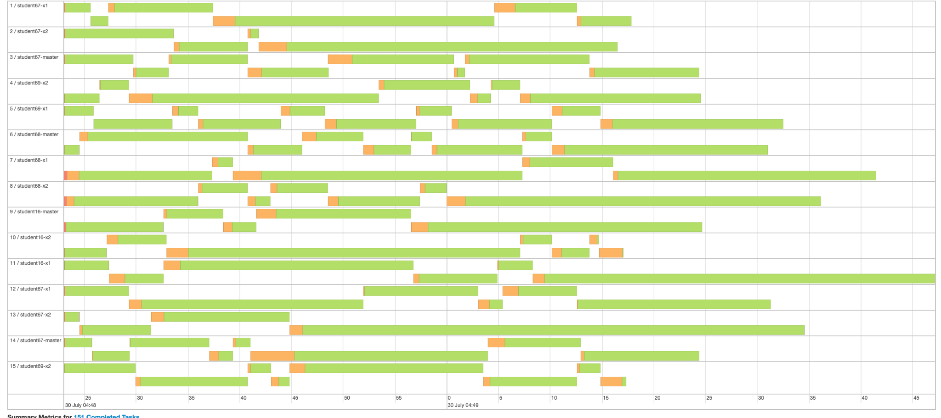
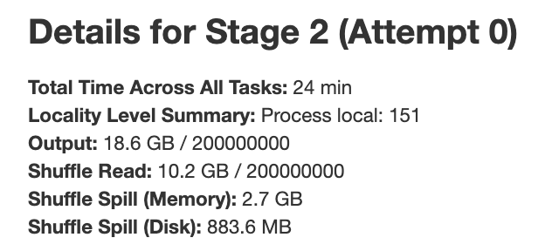
Number of executors: 15
spark-submit --driver-cores 1 --driver-memory 1g --num-executors 15 --executor-cores 1 --executor-memory 2g --conf spark.shuffle.compress=true --conf spark.default.parallelism=300 --class TeraSort --master yarn target/terasort-application-1.0.jar /terainput20g-128m /user/wongngaisum/spark_teraoutput-wns-1
Link: http://202.45.128.135:10669/history/application_1626360248822_0391/jobs/
Execution time: 141s
Most of the time spent on execution, good!
There were 4 nodes each ran 2 exectors, and they can REALLY run in parallel
=> Possible to increase number of executors to get better performance?
Similar shuffle spill

Slide 15
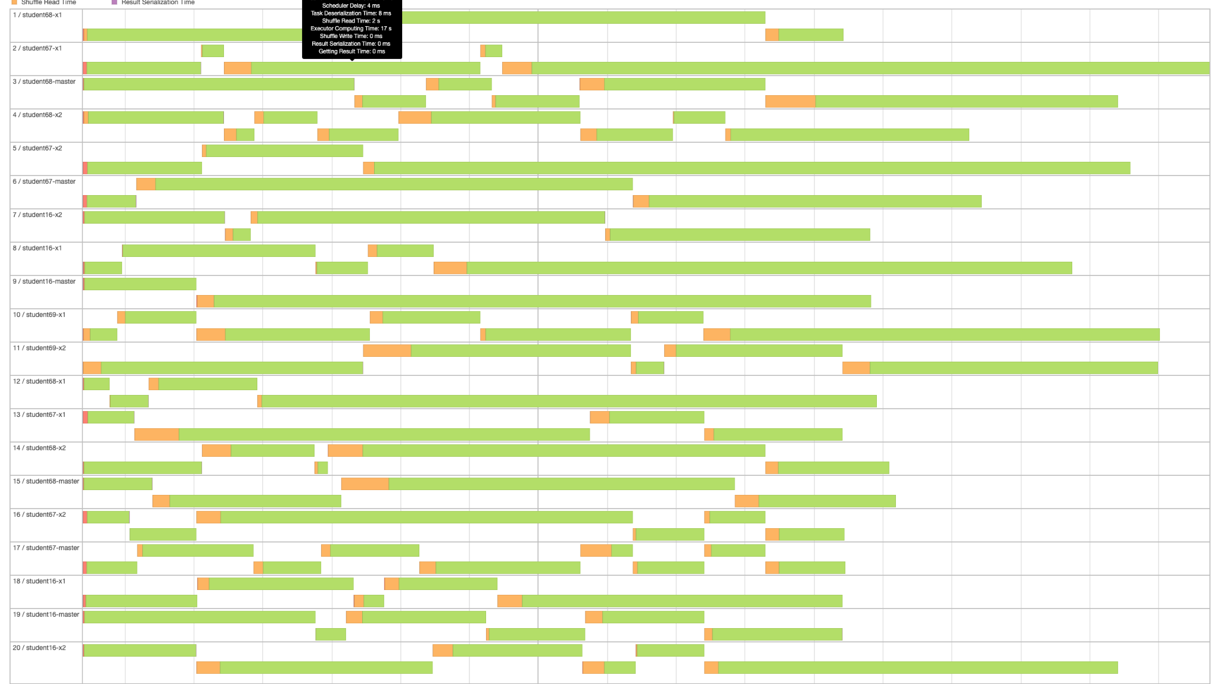
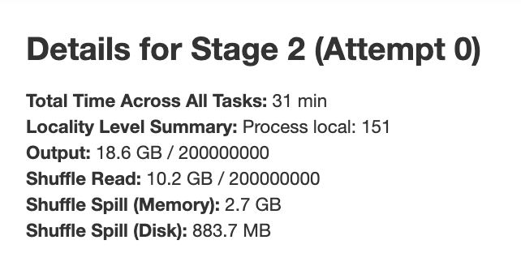
Number of executors: 20
spark-submit --driver-cores 1 --driver-memory 1g --num-executors 20 --executor-cores 1 --executor-memory 2g --conf spark.shuffle.compress=true --conf spark.default.parallelism=300 --class TeraSort --master yarn target/terasort-application-1.0.jar /terainput20g-128m /user/wongngaisum/spark_teraoutput-wns-1
Link: http://202.45.128.135:10669/history/application_1626360248822_0392/jobs/
Execution time: 129s (faster!)
Most of the time spent on execution, good!
There were 9 nodes each ran 2 exectors, and they can REALLY run in parallel
=> Possible to increase number of executors to get better performance?
Similar shuffle spill

Slide 16
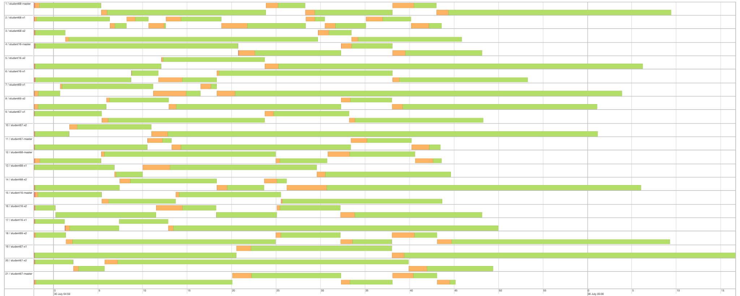
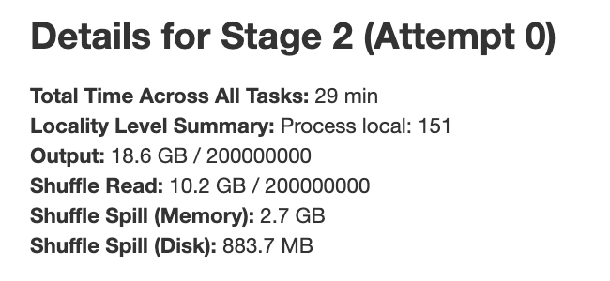
Number of executors: 25
spark-submit --driver-cores 1 --driver-memory 1g --num-executors 25 --executor-cores 1 --executor-memory 2g --conf spark.shuffle.compress=true --conf spark.default.parallelism=300 --class TeraSort --master yarn target/terasort-application-1.0.jar /terainput20g-128m /user/wongngaisum/spark_teraoutput-wns-1
Link: http://202.45.128.135:10669/history/application_1626360248822_0393/jobs/
Execution time: 123s (fastest!)
Most of the time spent on execution, good!
Only 21 executors created, not 25! Not enough memory!
Memory per executor = 2GB and only 5GB per node.
Cant run 3 executors on a node at the same time!
=> Adjust memory of executors
More executors were created thus better performance
Similar shuffle spill

Slide 17
Effects of changing no. of executors
Among the three values I test, no. of executors = 25 gives the best result. In this case, more executors can give better performance as they can run in parallel. Only 21 executors were actually created due to the large size of executor memory. For simplicity, I will use no. of executors = 25 to further tune other parameters. Hopefully, I will find better values of memory and number CPU cores of executors so better performance can be achieved.

Slide 18
Change Memory of Executors

Slide 19
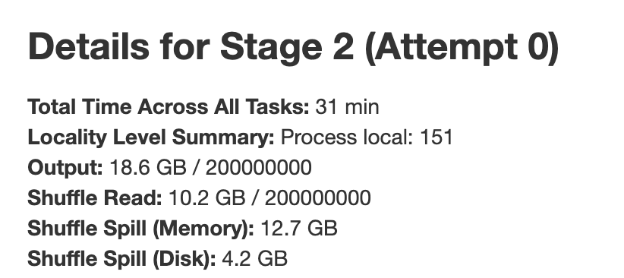
Executor memory: 1GB
spark-submit --driver-cores 1 --driver-memory 1g --num-executors 25 --executor-cores 1 --executor-memory 1g --conf spark.shuffle.compress=true --conf spark.default.parallelism=300 --class TeraSort --master yarn target/terasort-application-1.0.jar /terainput20g-128m /user/wongngaisum/spark_teraoutput-wns-1
Link: http://202.45.128.135:10669/history/application_1626360248822_0403/jobs/
Execution time: 117s, faster than before
All 25 executors can run!
More shuffle spill than before
Max duration: 59s

Slide 20
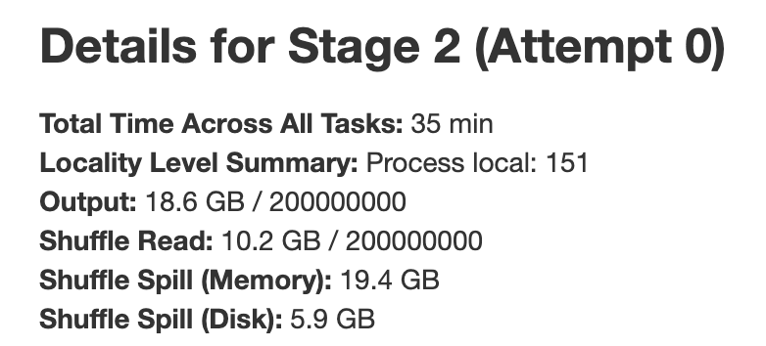
Executor memory: 800MB
spark-submit --driver-cores 1 --driver-memory 1g --num-executors 25 --executor-cores 1 --executor-memory 800m --conf spark.shuffle.compress=true --conf spark.default.parallelism=300 --class TeraSort --master yarn target/terasort-application-1.0.jar /terainput20g-128m /user/wongngaisum/spark_teraoutput-wns-1
Link: http://202.45.128.135:10669/history/application_1626360248822_0434/jobs/
Execution time: 123s, slightly worse performance
All 25 executors can run!
Reason for worse performance:
Less memory fraction for shuffle, => large shuffle
spill, => higher memory swap latency, => longer execution time
More shuffle spill than when memory=1G
Max duration: 1.2min, >59s!

Slide 21
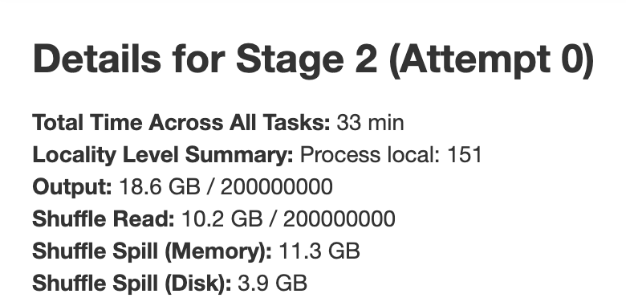
Executor memory: 1100MB
spark-submit --driver-cores 1 --driver-memory 1g --num-executors 25 --executor-cores 1 --executor-memory 1100m --conf spark.shuffle.compress=true --conf spark.default.parallelism=300 --class TeraSort --master yarn target/terasort-application-1.0.jar /terainput20g-128m /user/wongngaisum/spark_teraoutput-wns-1
Link: http://202.45.128.135:10669/history/application_1626360248822_0435/jobs/
Execution time: 121s, similar performance
All 25 executors can run, nodes still have enough
memory.
Less shuffle spill than when memory=1G
Max duration: 53s, best!

Slide 22
Effects of changing memory of executors
Among the three values I test, executor memory = 1GB gives the best result. Larger executor memory lowers shuffle spills. Although I believe executor memory = 1100MB may give better performance, but the “execution time” of an experiment varies a little among multiple runs. So for simplicity, I will just use executor memory = 1GB to further tune other parameters.

Slide 23
Change no. of CPU Cores and Memory of Executors

Slide 24
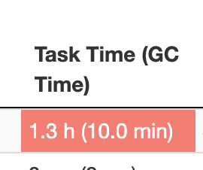
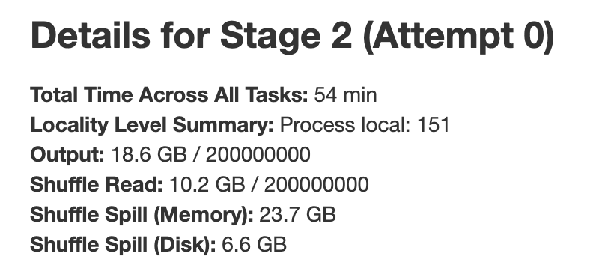
No. of executor cores: 2, memory: 1GB
spark-submit --driver-cores 1 --driver-memory 1g --num-executors 25 --executor-cores 2 --executor-memory 1g --conf spark.shuffle.compress=true --conf spark.default.parallelism=300 --class TeraSort --master yarn target/terasort-application-1.0.jar /terainput20g-128m /user/wongngaisum/spark_teraoutput-wns-1
Link: http://202.45.128.135:10669/history/application_1626360248822_0407/jobs/
Execution time: 129s, worse performance
Reasons for poor performace:
Each executor has 0.5GB memory, no enough memory to hold shuffle data
3 core per node, thus running 3 executors per node may be good, except that memory utilization is bad!
6.6GB data spilled to disk, high GC time!

Slide 25
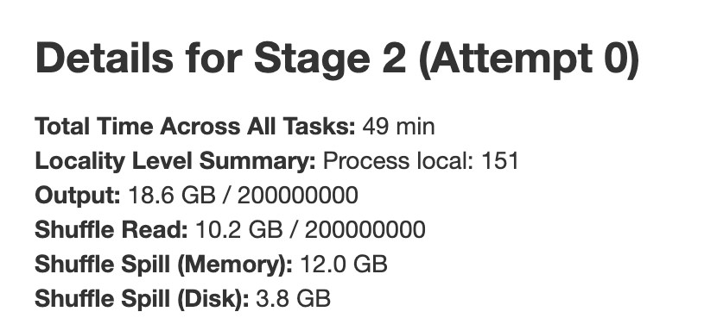
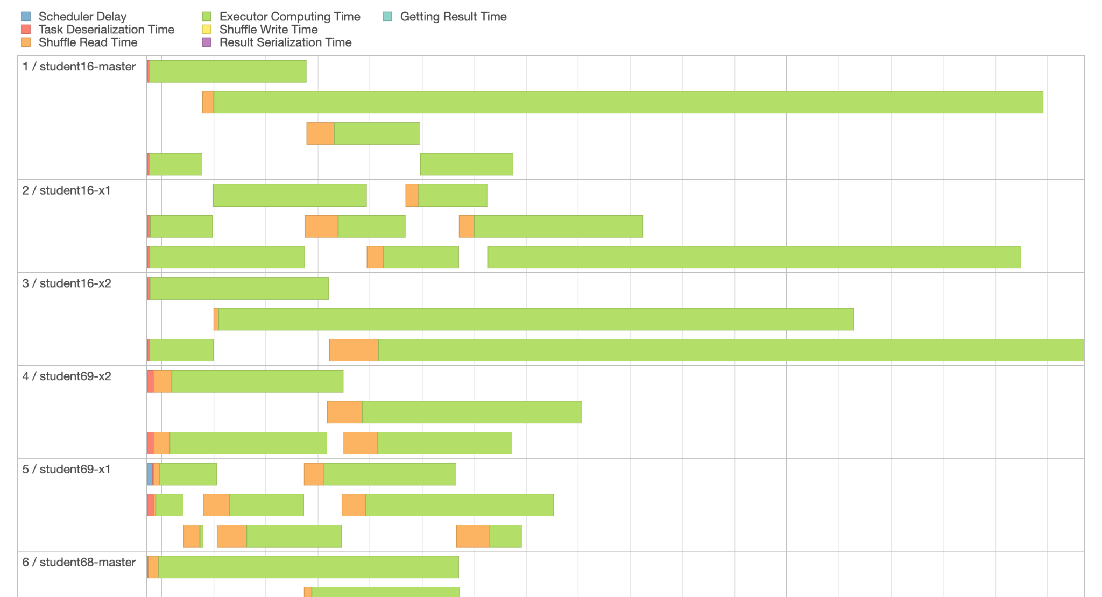
No. of executor cores: 2, memory: 2GB
spark-submit --driver-cores 1 --driver-memory 1g --num-executors 25 --executor-cores 2 --executor-memory 2g --conf spark.shuffle.compress=true --conf spark.default.parallelism=300 --class TeraSort --master yarn target/terasort-application-1.0.jar /terainput20g-128m /user/wongngaisum/spark_teraoutput-wns-1
Link: http://202.45.128.135:10669/history/application_1626360248822_0408/jobs/
Execution time: 122s, faster
Only 21 executors were running. Not enough memory to run all 25 executors!
Make use of running multiple tasks in the same JVM, but seems no cached RDD is created in TeraSort, so not that useful.
Why poor performance? Data skew!
Less shuffle spill

Slide 26
Effects of changing memory and no. of cores of executors
Among the values I tested, executor memory = 1GB and no. of cores per executor = 1 gives the best result. Increasing no. of CPU cores per executor usually gives better results as cached RDD can be reused quickly. However it is not useful in TeraSort. With no. of executor cores: 2 and memory: 2GB, I observed data skewness problem. It is important to balance workload among nodes. So for simplicity, I will just keep executor memory = 1GB and no. of cores per executor = 1 to further tune other parameters.

Slide 27
Adjust shuffle compress

Slide 28
spark.shuffle.compress: false (default true)
spark-submit --driver-cores 1 --driver-memory 1g --num-executors 25 --executor-cores 1 --executor-memory 1g --conf spark.shuffle.compress=false --conf spark.default.parallelism=300 --class TeraSort --master yarn target/terasort-application-1.0.jar /terainput20g-128m /user/wongngaisum/spark_teraoutput-wns-1
Link: http://202.45.128.135:10669/history/application_1626360248822_0423/jobs/
Execution time: 146s, 23s longer than with shuffle compress = true
Reasons:
Longer shuffle read and write, larger data spill

Slide 29
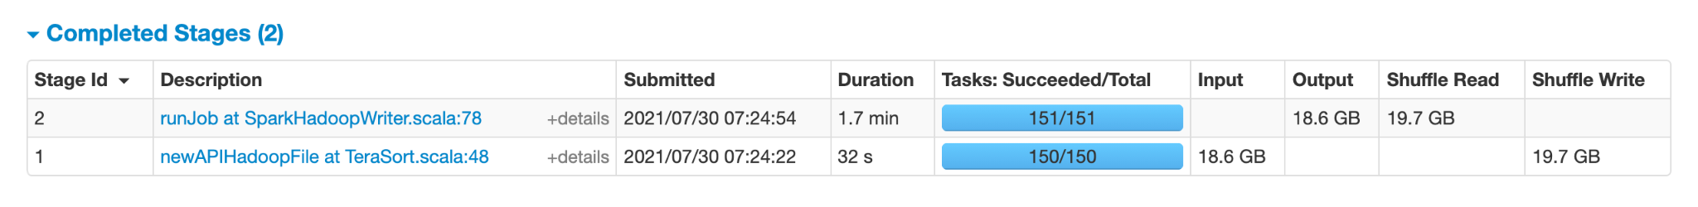
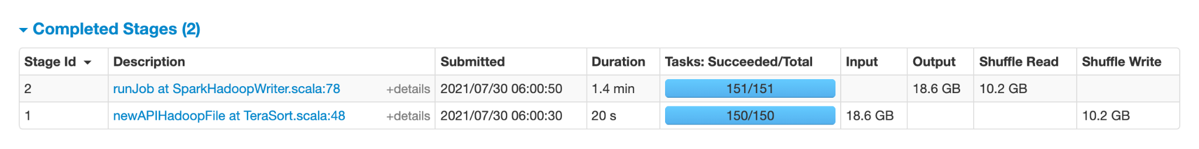
spark.shuffle.compress: false (default true)
Longer shuffle read and write, larger data spill
spark.shuffle.compress: false, job 1 shuffle data: 19.7GB
spark.shuffle.compress: true, job 1 shuffle data: 10.2GB
Conclusion:
Compressing map outputs is usually a good idea as network latency is expensive!

Slide 30
Adjust parallelism

Slide 31
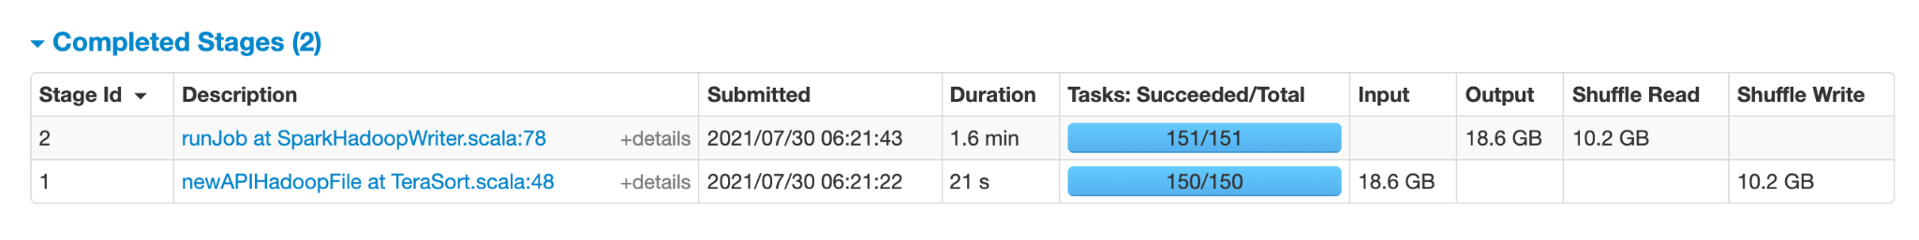
spark.default.parallelism: 250
spark-submit --driver-cores 1 --driver-memory 1g --num-executors 25 --executor-cores 1 --executor-memory 1g --conf spark.shuffle.compress=true --conf spark.default.parallelism=250 --class TeraSort --master yarn target/terasort-application-1.0.jar /terainput20g-128m /user/wongngaisum/spark_teraoutput-wns-1
Link: http://202.45.128.135:10669/history/application_1626360248822_0409/jobs/
Execution time: 125s
It doesnt affect number of tasks???

Slide 32
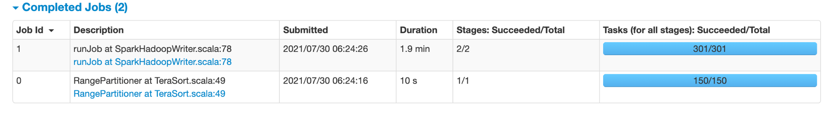
spark.default.parallelism: 350
spark-submit --driver-cores 1 --driver-memory 1g --num-executors 25 --executor-cores 1 --executor-memory 1g --conf spark.shuffle.compress=true --conf spark.default.parallelism=350 --class TeraSort --master yarn target/terasort-application-1.0.jar /terainput20g-128m /user/wongngaisum/spark_teraoutput-wns-1
Link: http://202.45.128.135:10669/history/application_1626360248822_0410/jobs/
Execution time: 124s
No big change in execution time. Same number of tasks!

Slide 33
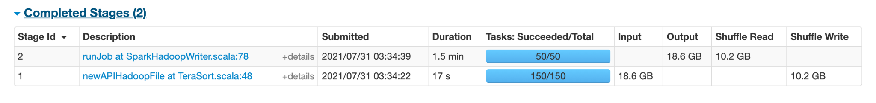
spark.default.parallelism: 50
spark-submit --driver-cores 1 --driver-memory 1g --num-executors 25 --executor-cores 1 --executor-memory 1g --conf spark.shuffle.compress=true --conf spark.default.parallelism=50 --class TeraSort --master yarn target/terasort-application-1.0.jar /terainput20g-128m /user/wongngaisum/spark_teraoutput-wns-1
Link: http://202.45.128.135:10669/history/application_1626360248822_0483/jobs/
Execution time: 118s
Faster execution, only 50 tasks were created in job 1 stage 1 (repartitionAndSortWithinPartitions).

Slide 34
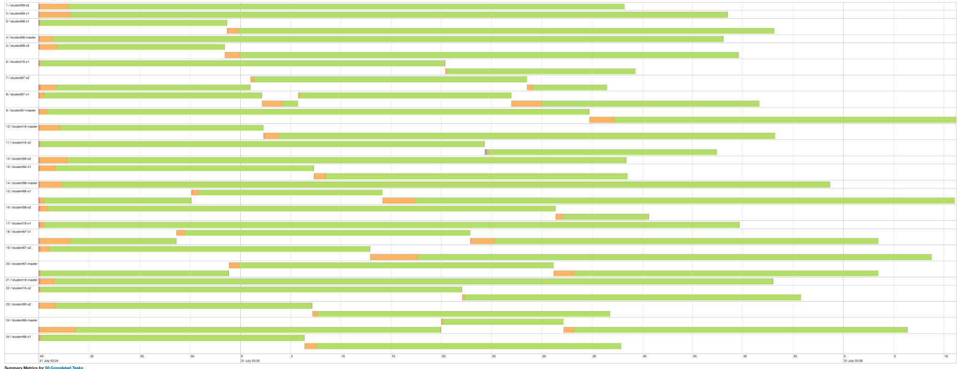
spark.default.parallelism: 50
On average each executor runs 2 tasks on average, maybe its good to make it 3 or 4?
Timeline:

Slide 35
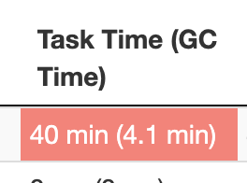
spark.default.parallelism: 75 (avg. 3 tasks per executor)
spark-submit --driver-cores 1 --driver-memory 1g --num-executors 25 --executor-cores 1 --executor-memory 1g --conf spark.shuffle.compress=true --conf spark.default.parallelism=75 --class TeraSort --master yarn target/terasort-application-1.0.jar /terainput20g-128m /user/wongngaisum/spark_teraoutput-wns-1
Link: http://202.45.128.135:10669/history/application_1626360248822_0486/jobs/
Execution time: 114s
Faster again. More balanced work load!
A little bit high GC

Slide 36
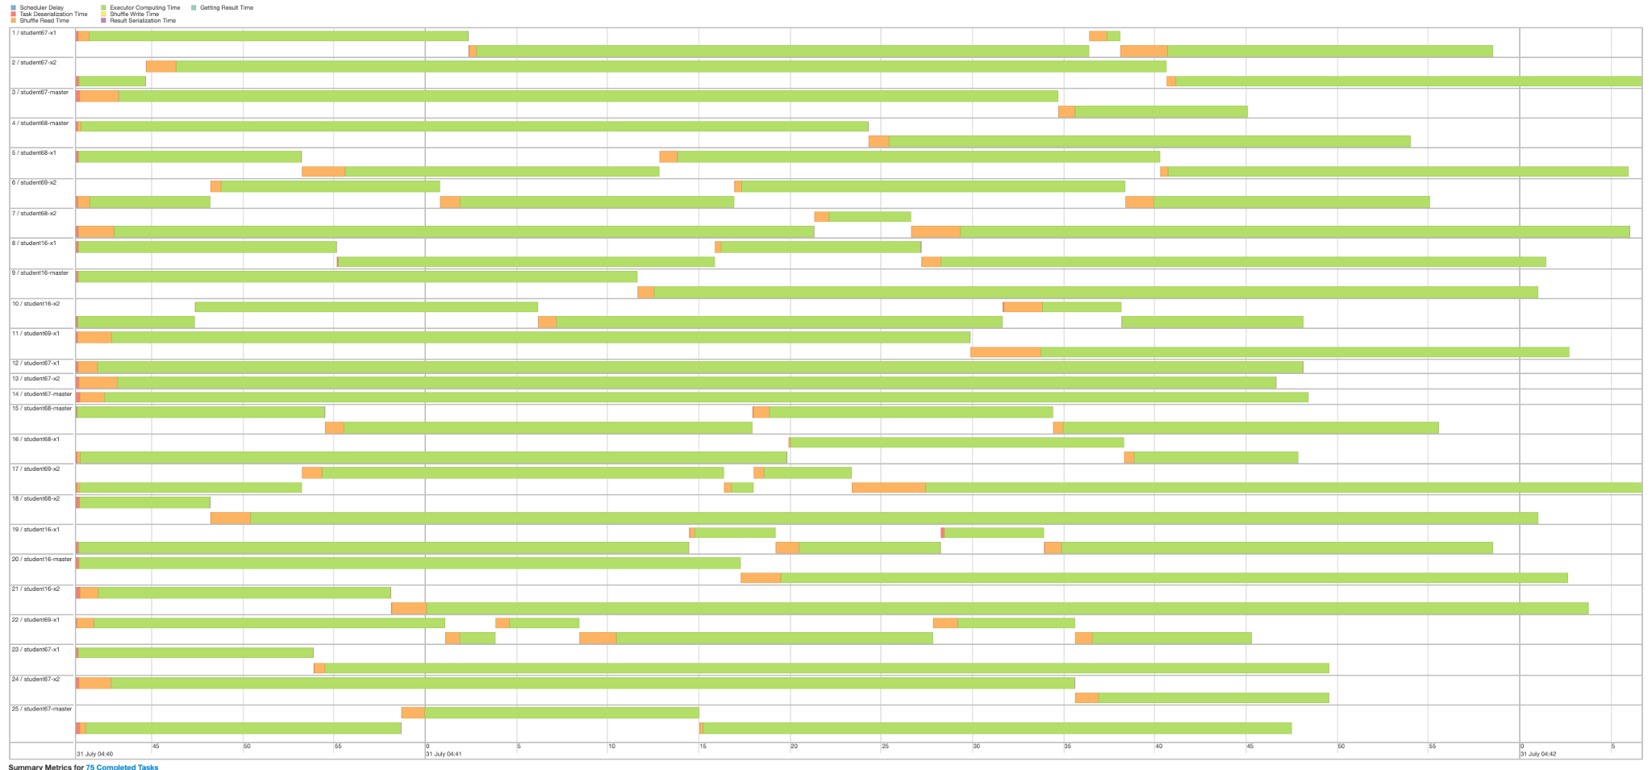
spark.default.parallelism: 75 (avg. 3 tasks per executor)
Timeline:

Slide 37
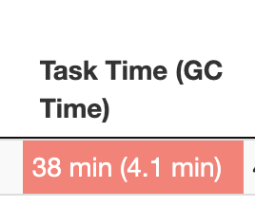
spark.default.parallelism: 100 (avg. 4 tasks per executor)
spark-submit --driver-cores 1 --driver-memory 1g --num-executors 25 --executor-cores 1 --executor-memory 1g --conf spark.shuffle.compress=true --conf spark.default.parallelism=100 --class TeraSort --master yarn target/terasort-application-1.0.jar /terainput20g-128m /user/wongngaisum/spark_teraoutput-wns-1
Link: http://202.45.128.135:10669/history/application_1626360248822_0483/jobs/
Execution time: 122s
Slower because of the data distribution of data.
A little bit high GC

Slide 38
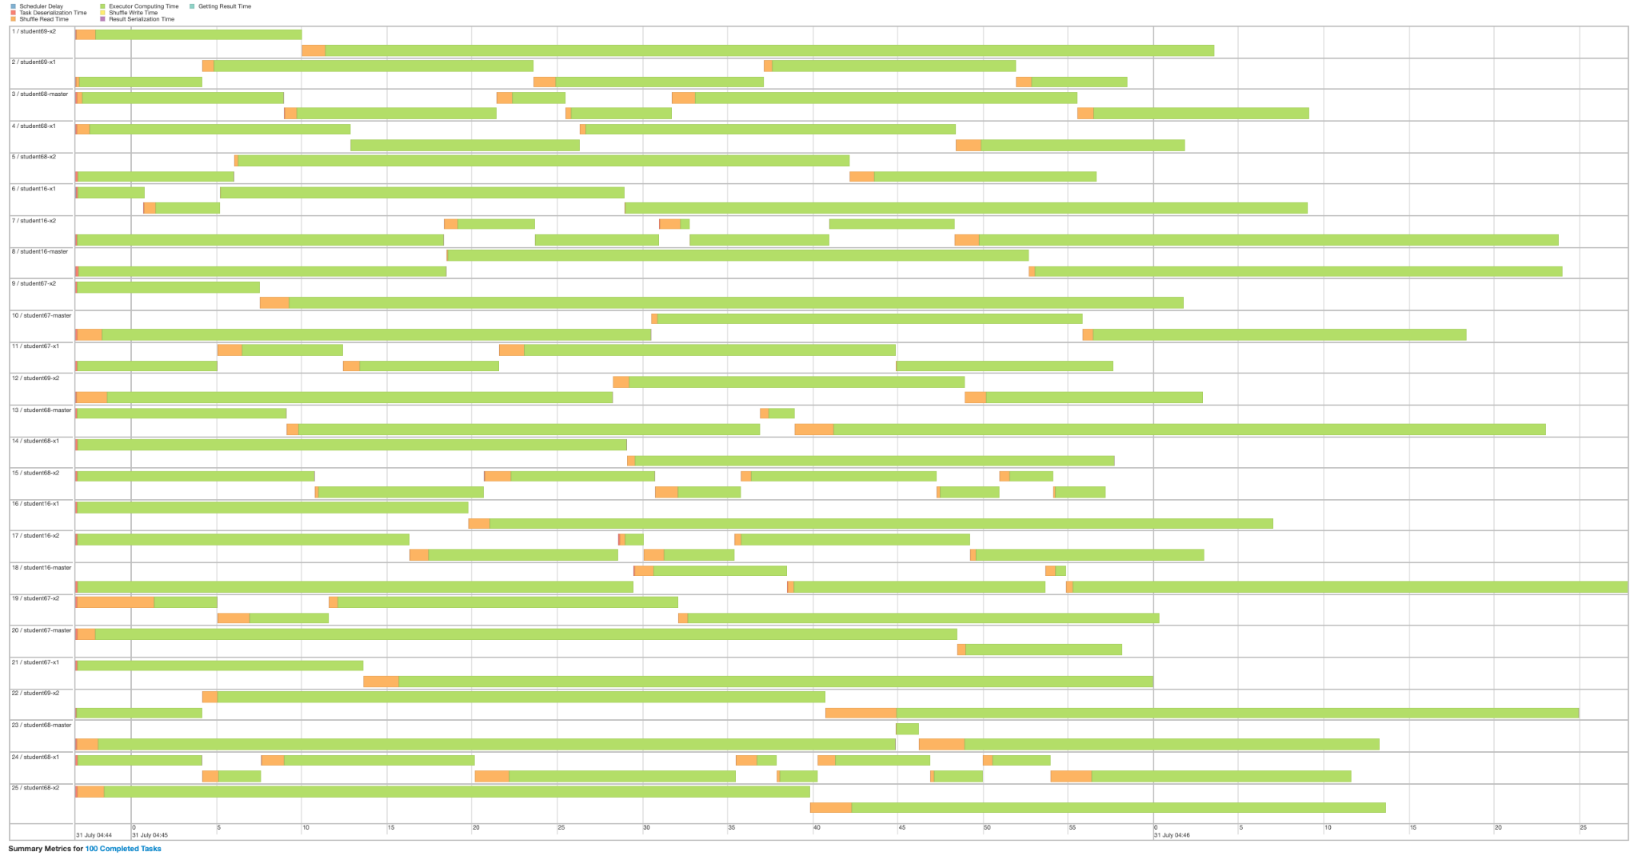
spark.default.parallelism: 100 (avg. 4 tasks per executor)
Timeline:

Slide 39
Effects of changing parallelism
If parallelism is 300, then there may be more time spent on scheduling and other minor things, but most of the execution time spent on real computing and deserialization, also smaller data spill.
In contrast, if parallelism is 50/75/100, then each task is bigger and larger data spill. But the performance may be affected by the data skewness of the execution.
So for simplicity, I will keep using 300 to further tune other parameters.

Slide 40
Adjust memory and no. of cores of driver

Slide 41
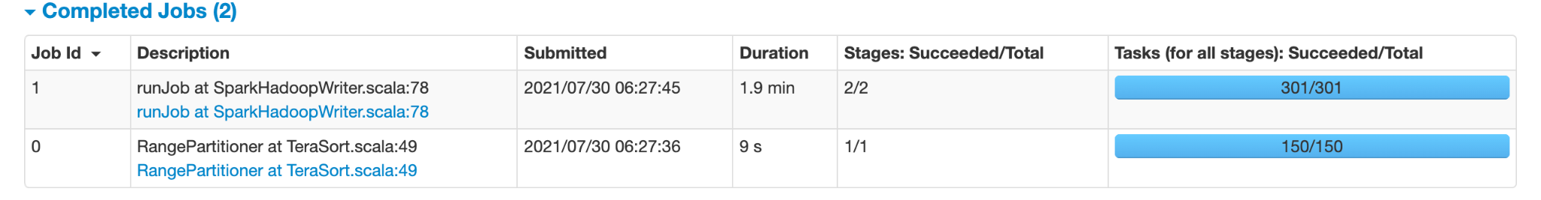
No. of driver cores: 2
spark-submit --driver-cores 2 --driver-memory 1g --num-executors 25 --executor-cores 1 --executor-memory 1g --conf spark.shuffle.compress=true --conf spark.default.parallelism=300 --class TeraSort --master yarn target/terasort-application-1.0.jar /terainput20g-128m /user/wongngaisum/spark_teraoutput-wns-1
Link: http://202.45.128.135:10669/history/application_1626360248822_0411/jobs/
Execution time: 121s

Slide 42
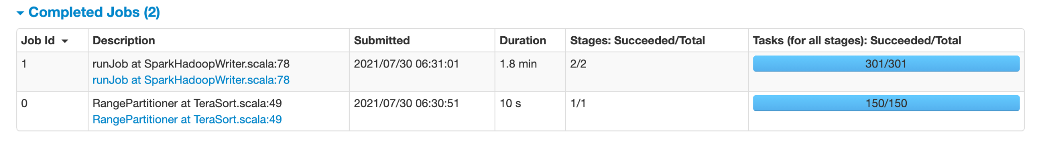
Driver memory: 2GB
spark-submit --driver-cores 1 --driver-memory 2g --num-executors 25 --executor-cores 1 --executor-memory 1g --conf spark.shuffle.compress=true --conf spark.default.parallelism=300 --class TeraSort --master yarn target/terasort-application-1.0.jar /terainput20g-128m /user/wongngaisum/spark_teraoutput-wns-1
Link: http://202.45.128.135:10669/history/application_1626360248822_0412/jobs/
Execution time: 120s

Slide 43
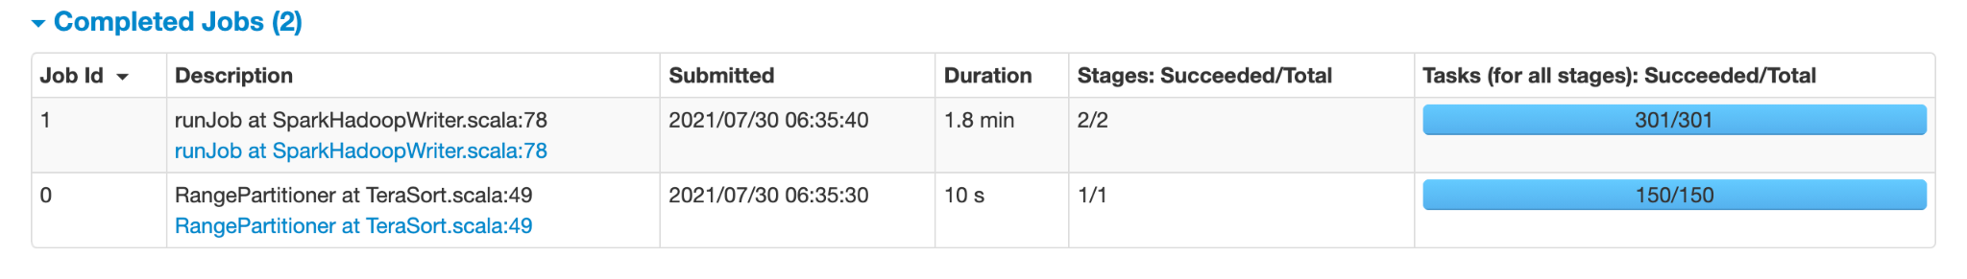
No. of driver cores: 2, driver memory: 2GB
spark-submit --driver-cores 2 --driver-memory 2g --num-executors 25 --executor-cores 1 --executor-memory 1g --conf spark.shuffle.compress=true --conf spark.default.parallelism=300 --class TeraSort --master yarn target/terasort-application-1.0.jar /terainput20g-128m /user/wongngaisum/spark_teraoutput-wns-1
Link: http://202.45.128.135:10669/history/application_1626360248822_0413/jobs/
Execution time: 120s

Slide 44
Effects of changing memory and no. of cores of driver
Spark driver is an orchestrator, creates SparkContext and receives result after running computation on a dataset. But in TeraSort, the applciation does not return sorted data to the driver. It just saves the output as new Hadoop file. So keeping the driver using 1 CPU core and 1GB of memory is sufficient.

Slide 45
Adjust locality wait

Slide 46
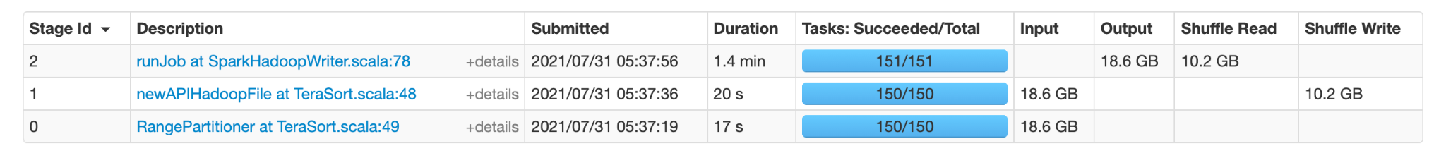
spark.locality.wait: 1 (default 3)
spark-submit --driver-cores 1 --driver-memory 1g --num-executors 25 --executor-cores 1 --executor-memory 1g --conf spark.locality.wait=1 --conf spark.default.parallelism=300 --class TeraSort --master yarn target/terasort-application-1.0.jar /terainput20g-128m /user/wongngaisum/spark_teraoutput-wns-1
Link: http://202.45.128.135:10669/history/application_1626360248822_0490/stages/
Execution time: 120s
It only affects stage 0 and 1! All stage 2 tasks are process local.

Slide 47
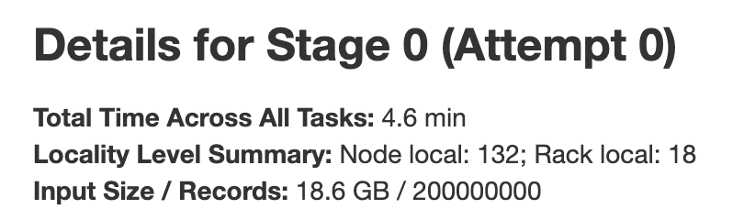
spark.locality.wait: 1 (default 3)
1 second delay for locality!

Slide 48
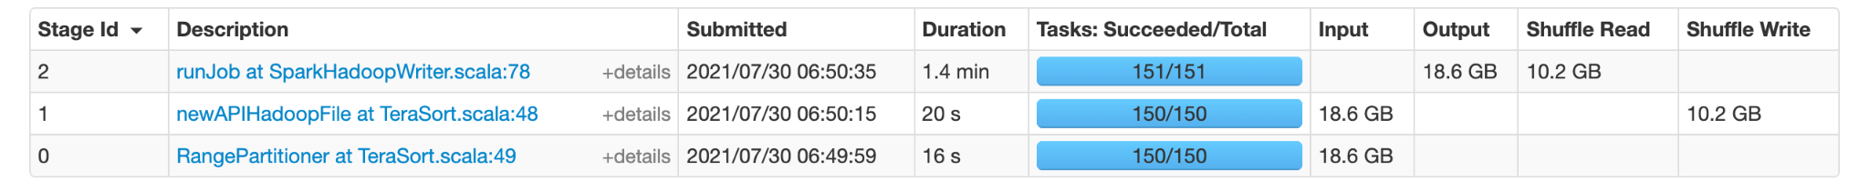
spark.locality.wait: 0 (default 3)
spark-submit --driver-cores 1 --driver-memory 1g --num-executors 25 --executor-cores 1 --executor-memory 1g --conf spark.locality.wait=0 --conf spark.default.parallelism=300 --class TeraSort --master yarn target/terasort-application-1.0.jar /terainput20g-128m /user/wongngaisum/spark_teraoutput-wns-1
Link: http://202.45.128.135:10669/history/application_1626360248822_0416/jobs/
Execution time: 121s
It only affects stage 0 and 1! All stage 2 tasks are process local.

Slide 49
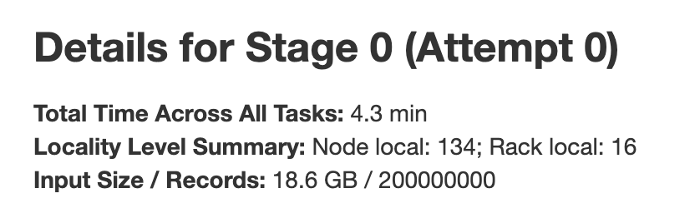
spark.locality.wait: 0 (default 3)
No delay for locality! Similar locality level, less total time across all tasks (4.3 vs 4.6).

Slide 50
Effects of changing locality wait
It seems good to make it 0. Because number of node local and rack local tasks are very similar. The total time across all tasks is lower with locality wait = 0. But I used the default value (3s) for futher tuning other parameters because I did experiments on other parameters first. I think it would not affect performance much because total time of stage 0 and stage 1 is little proportional to time spent on stage 2.

Slide 51
Adjust storage fraction

Slide 52
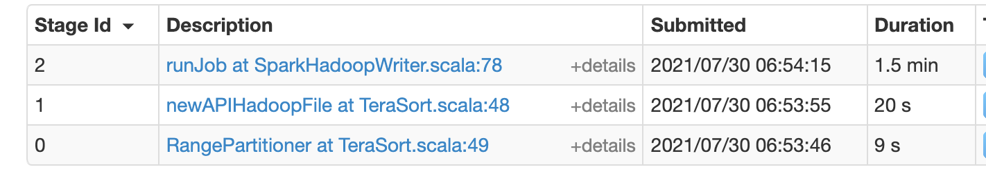
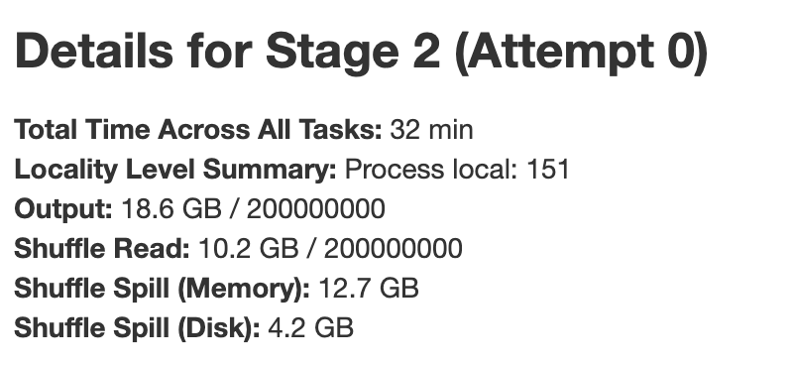
Memory storage fraction: 0.3 (default 0.5)
spark-submit --driver-cores 1 --driver-memory 1g --num-executors 25 --executor-cores 1 --executor-memory 1g --conf spark.memory.storageFraction=0.3 --conf spark.default.parallelism=300 --class TeraSort --master yarn target/terasort-application-1.0.jar /terainput20g-128m /user/wongngaisum/spark_teraoutput-wns-1
Link: http://202.45.128.135:10669/history/application_1626360248822_0417/jobs/
Execution time: 117.9s
No need to cache RDD in TeraSort! May be set it to 0!
Shuffle spill amount same as experiment with 0.5

Slide 53
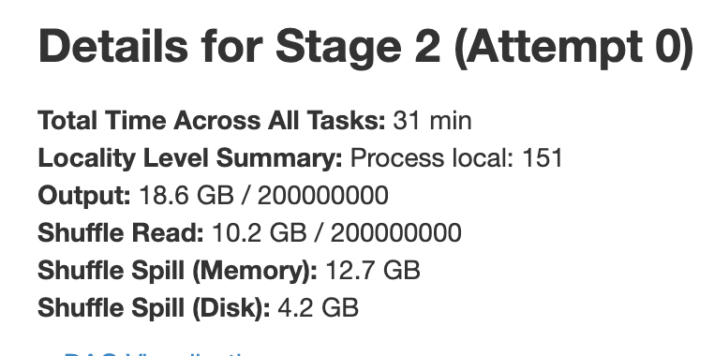
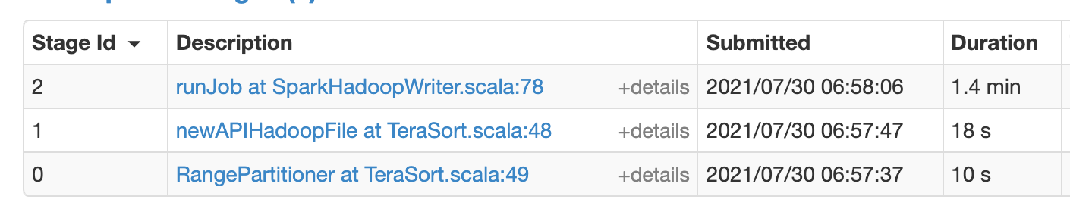
Memory storage fraction: 0 (default 0.5)
spark-submit --driver-cores 1 --driver-memory 1g --num-executors 25 --executor-cores 1 --executor-memory 1g --conf spark.memory.storageFraction=0 --conf spark.default.parallelism=300 --class TeraSort --master yarn target/terasort-application-1.0.jar /terainput20g-128m /user/wongngaisum/spark_teraoutput-wns-1
Link: http://202.45.128.135:10669/history/application_1626360248822_0418/jobs/
Execution time: 112.6s, slightly faster than before
Same shuffle spill amount, no effect on performance

Slide 54
Effects of changing memory storage fraction
It seems setting it to 0 does not affect the performance based on other parameter values. It seems executor has enough execution memory. But it is good to set it to 0 when I further tune the performance later.

Slide 55
Adjust other parameters

Slide 56
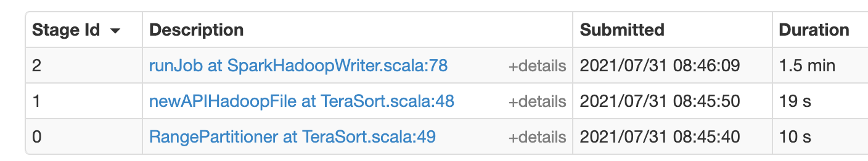
Memory fraction: 0.5 (default: 0.6)
spark-submit --driver-cores 1 --driver-memory 1g --num-executors 25 --executor-cores 1 --executor-memory 1g --conf spark.memory.storageFraction=0 --conf spark.memory.fraction=0.5 --conf spark.default.parallelism=300 --class TeraSort --master yarn target/terasort-application-1.0.jar /terainput20g-128m /user/wongngaisum/spark_teraoutput-wns-1
http://202.45.128.135:10669/history/application_1626360248822_0493/jobs/
Execution time: 119s
No big difference in performance

Slide 57
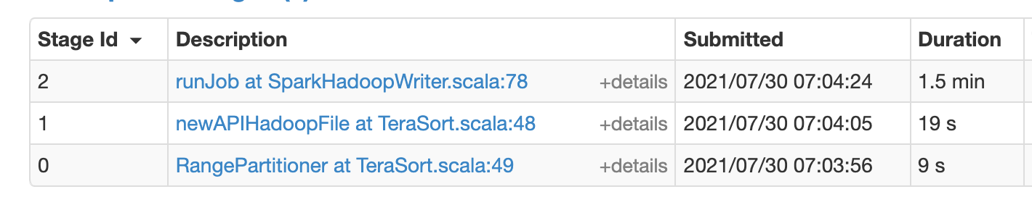
Memory fraction: 0.7 (default: 0.6)
spark-submit --driver-cores 1 --driver-memory 1g --num-executors 25 --executor-cores 1 --executor-memory 1g --conf spark.memory.storageFraction=0 --conf spark.memory.fraction=0.7 --conf spark.default.parallelism=300 --class TeraSort --master yarn target/terasort-application-1.0.jar /terainput20g-128m /user/wongngaisum/spark_teraoutput-wns-1
Link: http://202.45.128.135:10669/history/application_1626360248822_0419/jobs/
Execution time: 120.3s
No big difference in performance
As spark.memory.storageFraction=0, an executor has enough execution memory (even if memory fraction = 0.5)

Slide 58
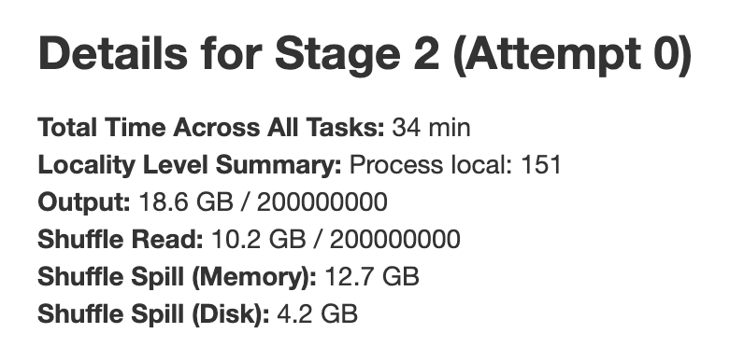
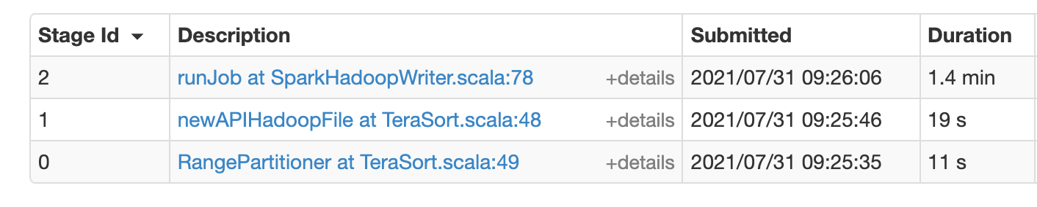
Shuffle memory fraction: 0.15 (default 0.2)
spark-submit --driver-cores 1 --driver-memory 1g --num-executors 25 --executor-cores 1 --executor-memory 1g --conf spark.shuffle.memoryFraction=0.15 --conf spark.memory.storageFraction=0 --conf spark.default.parallelism=300 --class TeraSort --master yarn target/terasort-application-1.0.jar /terainput20g-128m /user/wongngaisum/spark_teraoutput-wns-1
Link: http://202.45.128.135:10669/history/application_1626360248822_0494/jobs/
Execution time: 113s

Slide 59
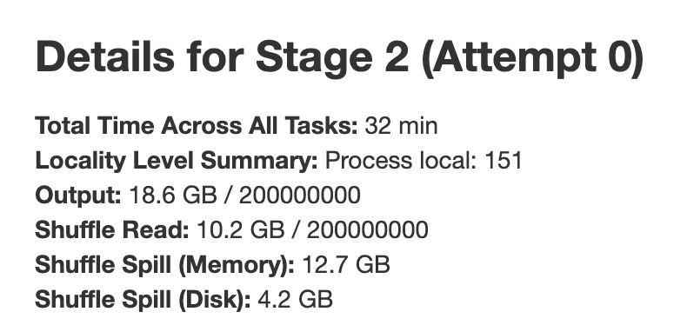
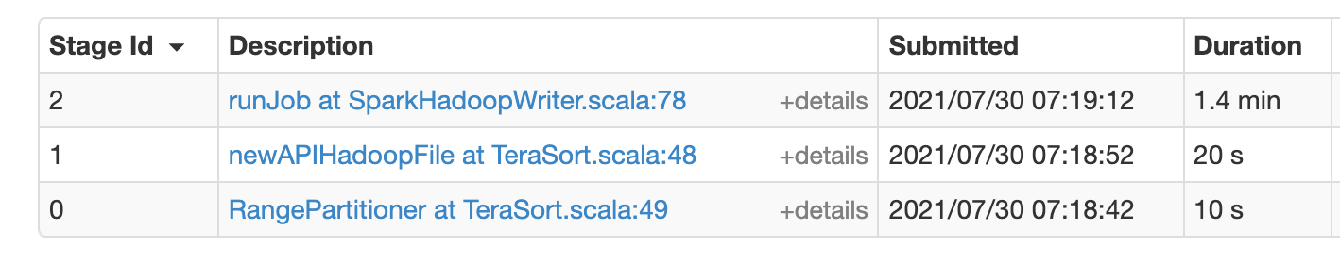
Shuffle memory fraction: 0.25 (default 0.2)
spark-submit --driver-cores 1 --driver-memory 1g --num-executors 25 --executor-cores 1 --executor-memory 1g --conf spark.shuffle.memoryFraction=0.25 --conf spark.memory.storageFraction=0 --conf spark.default.parallelism=300 --class TeraSort --master yarn target/terasort-application-1.0.jar /terainput20g-128m /user/wongngaisum/spark_teraoutput-wns-1
Link: http://202.45.128.135:10669/history/application_1626360248822_0422/jobs/
Execution time: 115.8s
Similar performance => not going to change it

Slide 60
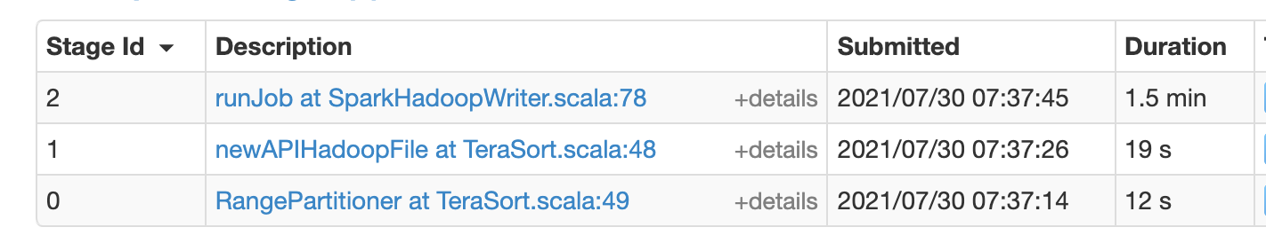
Shuffle file buffer: 16k (default 32k)
spark-submit --driver-cores 1 --driver-memory 1g --num-executors 25 --executor-cores 1 --executor-memory 1g --conf spark.shuffle.file.buffer=16k --conf spark.memory.storageFraction=0 --conf spark.default.parallelism=300 --class TeraSort --master yarn target/terasort-application-1.0.jar /terainput20g-128m /user/wongngaisum/spark_teraoutput-wns-1
Link: http://202.45.128.135:10669/history/application_1626360248822_0427/jobs/
Execution time: 119.3s
No big difference in performance

Slide 61

Shuffle file buffer: 64k (default 32k)
spark-submit --driver-cores 1 --driver-memory 1g --num-executors 25 --executor-cores 1 --executor-memory 1g --conf spark.shuffle.file.buffer=64k --conf spark.memory.storageFraction=0 --conf spark.default.parallelism=300 --class TeraSort --master yarn target/terasort-application-1.0.jar /terainput20g-128m /user/wongngaisum/spark_teraoutput-wns-1
Link: http://202.45.128.135:10669/history/application_1626360248822_0426/jobs/
Execution time: 118.4s
No big difference in performance

Slide 62

Shuffle file buffer: 96k (default 32k)
spark-submit --driver-cores 1 --driver-memory 1g --num-executors 25 --executor-cores 1 --executor-memory 1g --conf spark.shuffle.file.buffer=96k --conf spark.memory.storageFraction=0 --conf spark.default.parallelism=300 --class TeraSort --master yarn target/terasort-application-1.0.jar /terainput20g-128m /user/wongngaisum/spark_teraoutput-wns-1
Link: http://202.45.128.135:10669/history/application_1626360248822_0425/jobs/
Execution time: 119.6s
No big difference in performance

Slide 63

reducer.maxSizeInFlight: 96m (default 48m)
spark-submit --driver-cores 1 --driver-memory 1g --num-executors 25 --executor-cores 1 --executor-memory 1g --conf spark.reducer.maxSizeInFlight=96m --conf spark.memory.storageFraction=0 --conf spark.default.parallelism=300 --class TeraSort --master yarn target/terasort-application-1.0.jar /terainput20g-128m /user/wongngaisum/spark_teraoutput-wns-1
Link: http://202.45.128.135:10669/history/application_1626360248822_0428/jobs/
Execution time: 123s
No big difference in performance

Slide 64

reducer.maxSizeInFlight: 24m (default 48m)
spark-submit --driver-cores 1 --driver-memory 1g --num-executors 25 --executor-cores 1 --executor-memory 1g --conf spark.reducer.maxSizeInFlight=24m --conf spark.memory.storageFraction=0 --conf spark.default.parallelism=300 --class TeraSort --master yarn target/terasort-application-1.0.jar /terainput20g-128m /user/wongngaisum/spark_teraoutput-wns-1
Link: http://202.45.128.135:10669/history/application_1626360248822_0429/jobs/
Execution time: 119.2s
No big difference in performance

Slide 65

rdd.compress: true (default false)
spark-submit --driver-cores 1 --driver-memory 1g --num-executors 25 --executor-cores 1 --executor-memory 1g --conf spark.rdd.compress=true --conf spark.memory.storageFraction=0 --conf spark.default.parallelism=300 --class TeraSort --master yarn target/terasort-application-1.0.jar /terainput20g-128m /user/wongngaisum/spark_teraoutput-wns-1
Link: http://202.45.128.135:10669/history/application_1626360248822_0430/jobs/
Execution time: 117.7s
No big difference in performance

Slide 66
Further tune parameters...

Slide 67
Simplest and best performant config
spark-submit --driver-cores 1 --driver-memory 1g --num-executors 25 --executor-cores 1 --executor-memory 1g --conf spark.memory.storageFraction=0 --conf spark.default.parallelism=300 --class TeraSort --master yarn target/terasort-application-1.0.jar /terainput20g-128m /user/wongngaisum/spark_teraoutput-wns-1
After understanding how some parameters affect the performance, I am going to change multiple parameters on this config to see the change in performance.

Slide 68

More cores and memory, less executors (1)
spark-submit --driver-cores 1 --driver-memory 1g --num-executors 12 --executor-cores 2 --executor-memory 2g --conf spark.memory.storageFraction=0 --conf spark.default.parallelism=300 --class TeraSort --master yarn target/terasort-application-1.0.jar /terainput20g-128m /user/wongngaisum/spark_teraoutput-wns-1
Link: http://202.45.128.135:10669/history/application_1626360248822_0436/jobs/
Execution time: 109s
no. of executors: 25 -> 12
executor cores: 1 -> 2
executor memory: 1 -> 2g

Slide 69




More cores and memory, less executors (1)
Execution time: 109s
After: (High GC time!)
Before (p.53):

Slide 70

More cores and memory, less executors (2)
spark-submit --driver-cores 1 --driver-memory 1g --num-executors 11 --executor-cores 2 --executor-memory 2g --conf spark.memory.storageFraction=0 --conf spark.default.parallelism=300 --class TeraSort --master yarn target/terasort-application-1.0.jar /terainput20g-128m /user/wongngaisum/spark_teraoutput-wns-1
Link: http://202.45.128.135:10669/history/application_1626360248822_0437/jobs/
Execution time: 119s,
10s longer than with 12 executors?
no. of executors: 25 -> 11 (no. of worker nodes)
executor cores: 1 -> 2
executor memory: 1 -> 2g

Slide 71


More cores and memory, less executors (2)
Execution time: 119s
12 executors:
11 executors:

Slide 72


More cores and memory, less executors (2)
12 executors:
11 executors:
More tasks per executor and longer task time…
=> 2 executors (2 CPU cores each) can run on a node sharing CPU cores with moderate perfoamce

Slide 73

Adjust executor memory (1)
spark-submit --driver-cores 1 --driver-memory 1g --num-executors 12 --executor-cores 2 --executor-memory 2200m --conf spark.memory.storageFraction=0 --conf spark.default.parallelism=300 --class TeraSort --master yarn target/terasort-application-1.0.jar /terainput20g-128m /user/wongngaisum/spark_teraoutput-wns-1
Link: http://202.45.128.135:10669/history/application_1626360248822_0438/jobs/
Execution time: 133s
Not very good performance.
Apart from imbalanced workload,
each executor uses ~2600MB memory, each k8s container has 5GB of memory.
There is 12 executors but only 11 worker nodes. => Stragglers?

Slide 74

Adjust executor memory (2)
spark-submit --driver-cores 1 --driver-memory 1g --num-executors 12 --executor-cores 2 --executor-memory 1800m --conf spark.memory.storageFraction=0 --conf spark.default.parallelism=300 --class TeraSort --master yarn target/terasort-application-1.0.jar /terainput20g-128m /user/wongngaisum/spark_teraoutput-wns-1
Link: http://202.45.128.135:10669/history/application_1626360248822_0439/jobs/
Execution time: 126s
Faster execution,
but also umbalanced workload.

Slide 75
Fastest trial: 104s

Slide 76

Fastest trial: 104s
spark-submit --driver-cores 1 --driver-memory 1g --num-executors 15 --executor-cores 2 --executor-memory 1700m --conf spark.memory.storageFraction=0 --conf spark.default.parallelism=300 --conf spark.shuffle.file.buffer=256k --conf spark.reducer.maxSizeInFlight=96m --class TeraSort --master yarn target/terasort-application-1.0.jar /terainput20g-128m /user/wongngaisum/spark_teraoutput-wns-1
Link: http://202.45.128.135:10669/history/application_1626360248822_0524/jobs/

Slide 77

Duration of Job 1: 97s

Slide 78

Executor metrics (Stage 2)

Slide 79

Summary metrics

Slide 80
Choice of parameter values
driver-cores 1
driver-memory 1g
num-executors 15
executor-cores 2
executor-memory 1700m
spark.memory.storageFraction=0
spark.default.parallelism=300
spark.shuffle.file.buffer=256k
spark.reducer.maxSizeInFlight=96m

Slide 81
Reasons of choosing these parameter values
driver-cores 1
driver-memory 1g
As tested, 1 CPU core and 1GB memory for driver is enough.

Slide 82
Reasons of choosing these parameter values
spark.memory.storageFraction=0
As aforementioned, there is no need to cache RDD in TeraSort. Setting this value to 0 increases amount of execution memory as well as performance.

Slide 83

Reasons of choosing these parameter values
executor-cores 2, executor-memory 1700m
Each k8s container has 3 CPU cores and 5GB memory. Spark executors can share CPU cores and each executor uses ~2100MB of memory (including overhead). It leaves ~800MB of memory to underlying lightweight “OS”. As some minimal Linux distributions only require 512MB of memory. 800MB of memory should be enough for dockerized Ubuntu.

Slide 84
Reasons of choosing these parameter values
num-executors 15
I tried different number of executors, 15 gives better performance than 11, 12 and 30.

Slide 85
Reasons of choosing these parameter values
spark.default.parallelism=300
It does not affect number of tasks in stage 2 (151 tasks).
As 151/(15x2) ≈ 5 tasks per executor, which is acceptable. Just keep it simple.
spark.shuffle.file.buffer=256k (default 32k)
As data in TeraSort is extremely large, it reduces number of disk IO during shuffle write in map stage, hence improving performance.

Slide 86
Reasons of choosing these parameter values
spark.reducer.maxSizeInFlight=96m
It increases maximum size of map outputs to fetch simultaneously from each reduce task. It reduces number of data transfer on the internet and hence reduces latency. As I set spark.memory.storageFraction=0, each executor has 1700x0.6 = 1020MB execution memory. Setting this value to 96m usually does not cause out-of-memory error.

Slide 87
Reasons for varying execution time among different runs
There are many possible reasons:
After I ran TeraSort a lot of times, the 4 physical machines are running super hot so the execution time of Spark jobs with the same parameter values may vary largely.
The locations to create Spark executors may differ in each Spark job. The execution order and districution of tasks may not be the same in each Spark job. Also, the hardware of the 4 physical machines may not be the same.
Thus there is no guarantee that 104s can always be achieved with the same configuration. Of course it is also possible to run less than 104s.

Slide 88
Which parameters impact the sorting performance most significantly?

Slide 89
List of important parameters
num-executors and executor-cores and executor-memory
Reaons: These three are the most common parameters for performance tuning. I need to set suitable values such that all k8s containers are busy, there is enough execution memory and no frequent resouce competition (e.g. context switching, memory swap) between executors in a k8s container. Otherwise, the difference in execution time may be more than 30s, which is very expensive. Also, I need to ensure that the configuration would not exceed the hardware configuration of k8s containers.

Slide 90
List of important parameters
spark.memory.storageFraction
Reasons: No need to cache RDD, can set it to 0 to utilize memory and reduce chance of OOM error. Thus I may reduce memory of executor.
spark.default.parallelism
This controls number of tasks created in stage 2. If it is low (e.g. same as number of executors), then there would be significant imbalanced workload problem (due to data skewness). Also, if it is less than number of executors, then some worker nodes would not run any task.

Slide 91

I ran 143 times TeraSort.

Slide 92
End.
Thanks for reading!

